Slide 1
Studying a
Masters of Education
Dictionary
x
Words
@ the University of Canberra

Slide 2
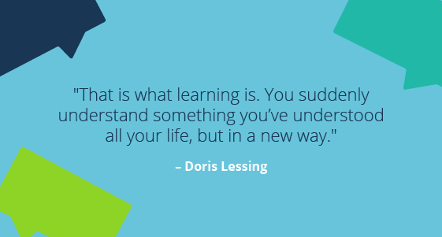
Contents
Skills
Context
Courses
Assignments
Benefits
Challenges

Slide 3



Skills - Learning and Literacy
WordArt
Love of Learning
Academic (Formal) Writing and Editing Skills
High Level Reading Comprehension Skills
(Highlighting, Note-taking, Making Connections)
Verbal Communication Skills (Discussing)
Organised (Scheduling)
Notes:
Be motivated! If you don’t love learning, you won’t be motivated!
Lots of writing!
Lots of reading!
Communicate early with lecturers if you have questions or problems. Contribute during intensive sessions! Discuss things with colleagues, even if their eyes glaze over!
Be on top of your assignments… I got into trouble when I had two major assignments due on the same day. 5, 500 words in total. Keep in mind the Semesters are short!

Slide 4


Recommended Personal Context
Supportive school;
Some time in your life to complete assignments;
Avoid taking on too many new responsibilities/ roles (can’t always be avoided!);
Awareness that you may get behind on your school responsibilities (e.g. marking)
‘Master’ teacher - be able to adapt and be flexible in your own classes.
Notes:
Take into consideration all of your personal and professional responsibilities.
Your family can get sad.

Slide 5






Courses Completed/ Started
Educational Research Perspectives
Leading Coaching and Mentoring
Qualitative Statistics
Educational Leadership and Change
Words

Slide 6
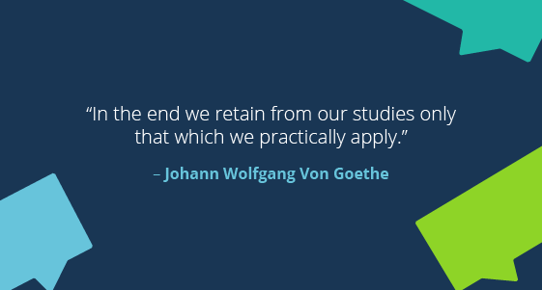
Assignments
Fun
Relevant
Applicable

Slide 7
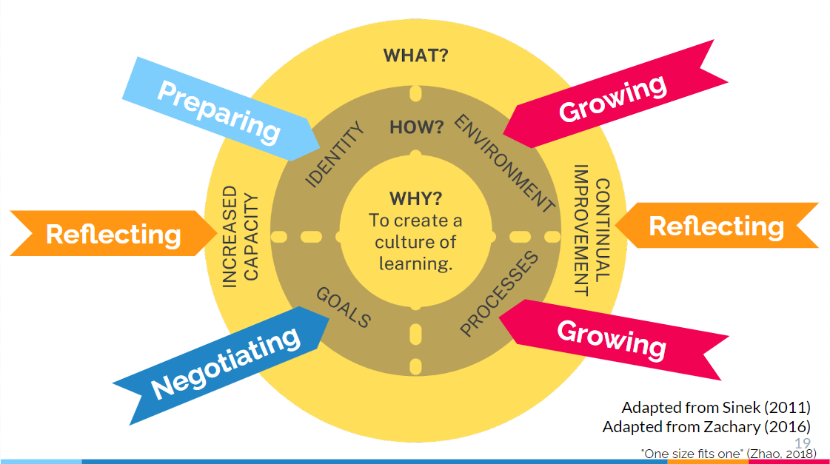
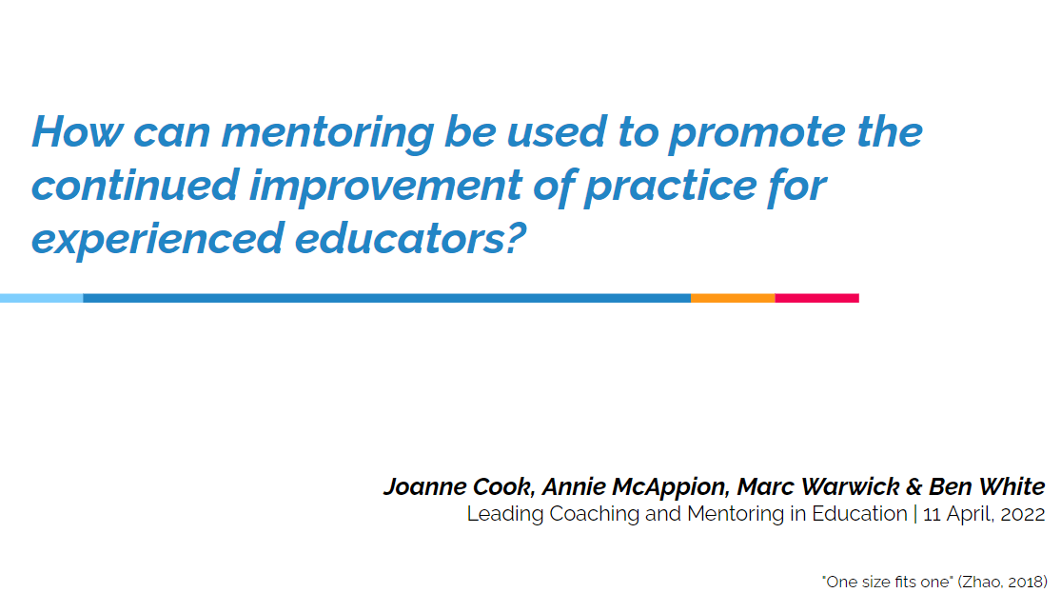
Sample Assignment - Group Presentation
Dictionary

Slide 8
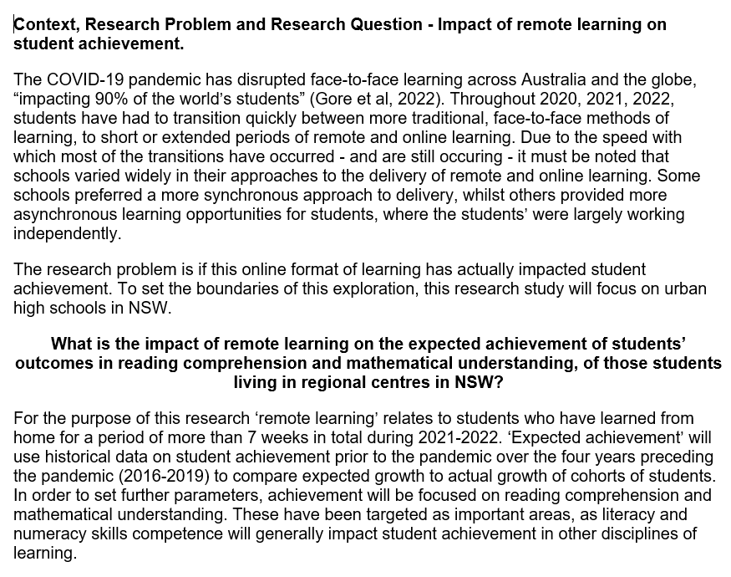
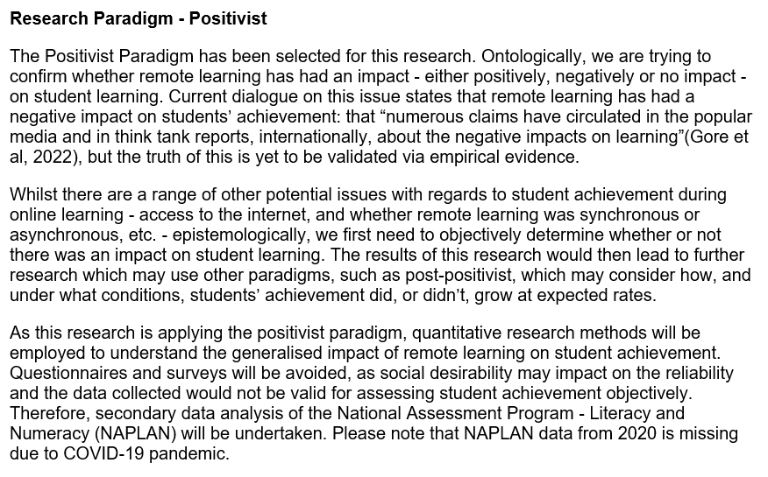
Sample Assignment - Research Proposal

Slide 9
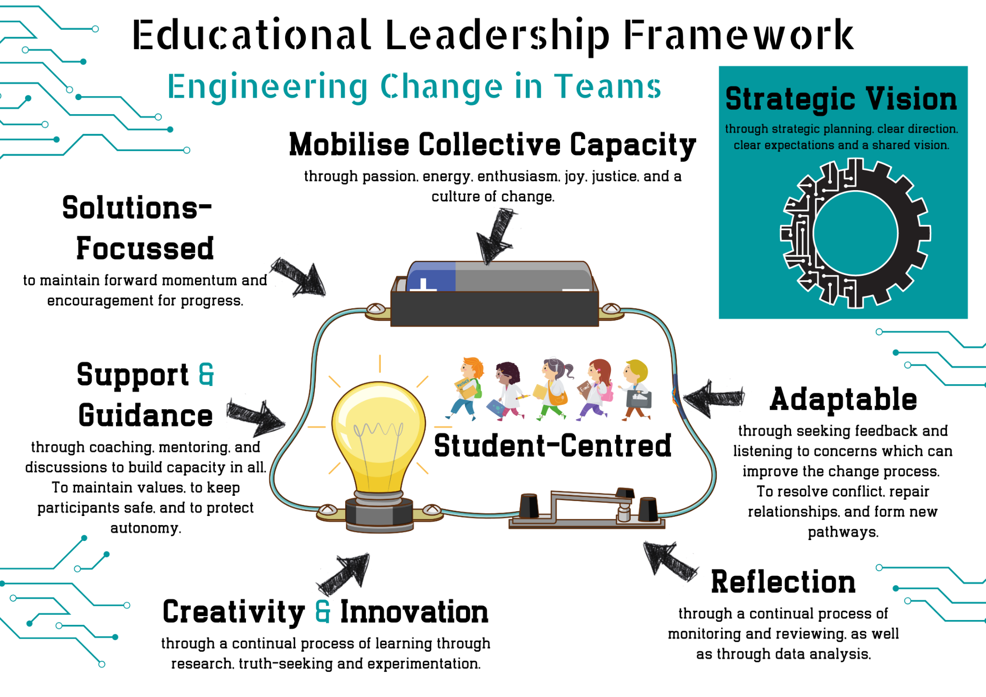
Sample Assignment - Framework
Dictionary

Slide 10
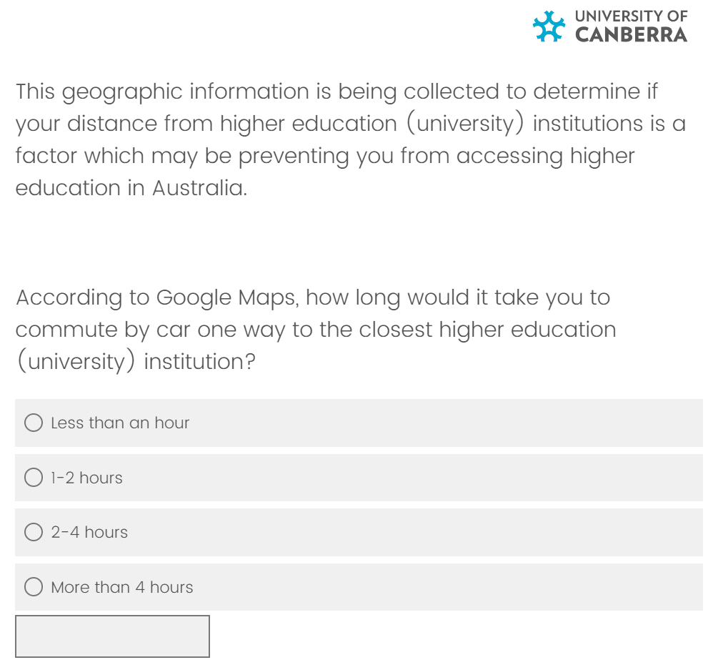
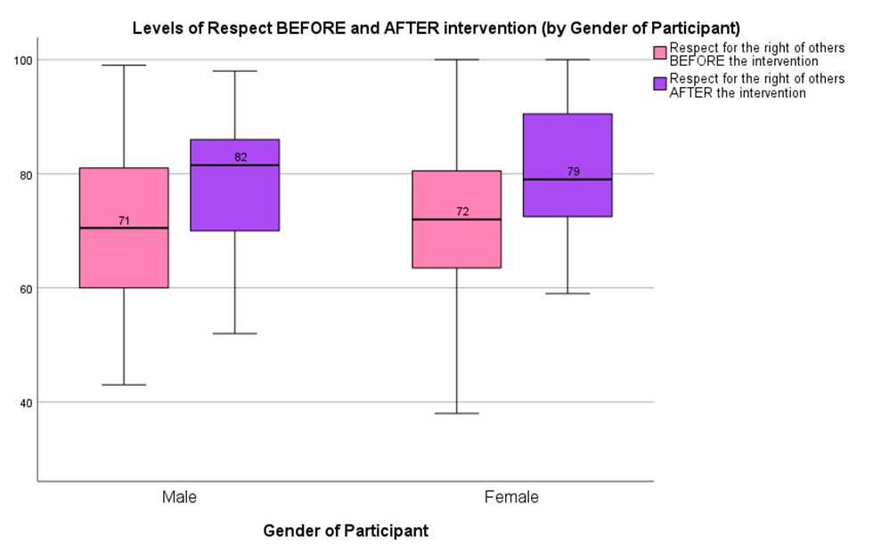
Sample Assignment - Surveys & SPSS

Slide 11
Benefits
Fun
Interesting
Relevant
Applicable
Networking

Slide 12
Challenges
Managing the workload
Balancing family, work and study.
Lose some weekends!
Managing time.

Slide 13

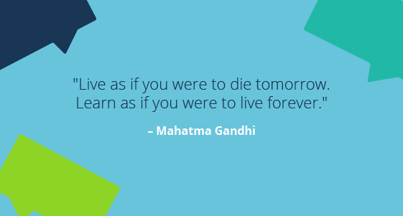

Slide 14
Thanks!
Do you have any questions?
Joanne.Cook@ed.act.edu.au
Please keep this slide for attribution
Dictionary

